Slide 1

Health Science Honor Society
SPX 210 @6:00PM
September 3, 2015
Notes:
start @ 6:05pm

Slide 2

Agenda
Introduction
Ice Breaker
HS2 Requirements
  Volunteer Hours, GPA, etc.
Past Events
HS2 Fee
Questions
Notes:
Claudia

Slide 3
Introduction
The Health Science Honor Society (HS2) at San Jose State University is an honor society that acknowledges and awards undergraduate students in the Health Science Department for academic excellence and passion in Health Science.
The organization's members are encouraged to keep their grades up as well as be involved in the community through volunteer work in various places.
Notes:
Claudia

Slide 4

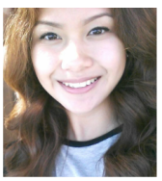
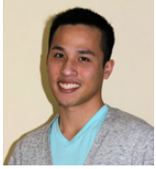
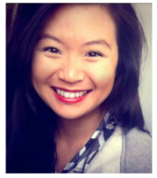
Board Members
President
Claudia
Gonzalez
Vice President
Joyce
Juniega
Treasurer
Trey Ngo
Social Media Coordinator
Chris Le
Volunteer Coordinator
Beverly Bares
Secretary
Sylvia La
Notes:
Everyone: option, year/expected graduation, cool fact

Slide 5

Ice Breaker
Notes:
Chris
Whoever wins will have lifesavers

Slide 6


Requirements: To Join
Must be a declared Health Science major
Have taken at least a semester of Health Science classes
3.0 SJSU GPA
3.5 Health Science GPA (calculated using GPA calculator or on Academic Requirements)
Notes:
Sylvia

Slide 7
Requirements: To Join
Fill out and turn in application
Application deadline is
September 11th at 4:00pm
Turn in the application at the
Health Science & Recreation Office SPX 212
Notes:
Sylvia

Slide 8


Requirements
20 hours of volunteering
  Not paid
  Can’t be part of a class
Volunteer Opportunities
  Comida Casera
  Volunteer now http://as.sjsu.edu/cccac/index.jsp?val=cccac_volunteernow
  VolunteerMatch.org http://www.volunteermatch.org
2 events
  PHE
  Writing Workshop
  SJSU Academic Events
  Outside events (health-related)
  HS2 Events
  HLO Mixer Panel
Notes:
Beverly
What counts:
PHE Events
Workshops
SJSU Events
Volunteering Service:

Slide 9
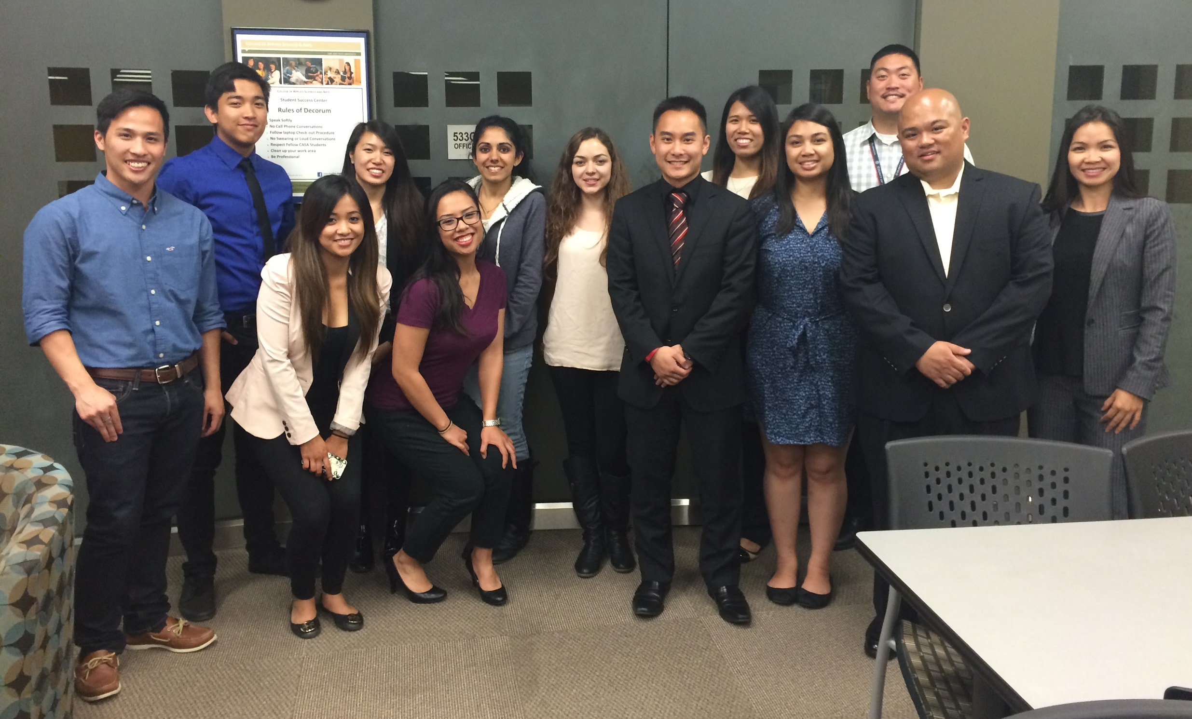
Past HS2 Events
Notes:
Joyce

Slide 10

HS2 Fees
One-time membership fee of $80
Why?
Can be paid in installments, please talk to Trey about further information TreyNgo@gmail.com
Notes:
Trey- money goes to stoles and also any public events we have, they will cover food. Also the money would go to awards/certificates, T-shirts, guest speaker gratitude gifts.

Slide 11


Contact Us
healthsciencehonorsociety@gmail.com
www.SJSUHS2.weebly.com
https://www.facebook.com/groups/252381281501540/
search for “Health Science Honor Society (HS2
@sjsu_hs2
Notes:
Chris

Slide 12

Questions?
Comments?
Notes:
Claudia

Slide 13
We look forward to having you part of HS2!

