Slide 1

Health Science Honor Society
YUH 243 @ 6:00PM
September 17, 2015
Notes:
start @ 6:05pm

Slide 2

Agenda
Introduction
Ice Breaker
New for Fall 2015
HS2 Requirements
  Volunteer Hours, GPA, etc.
Member Meetings
Events for this semester
HS2 Fee
T-shirts
Fundraising
Questions
Notes:
Claudia

Slide 3
Introduction
The Health Science Honor Society (HS2) at San Jose State University is an honor society that acknowledges and awards undergraduate students in the Health Science Department for academic excellence and passion in Health Science.
The organization's members are encouraged to keep their grades up as well as be involved in the community through volunteer work in various places.
Notes:
Claudia

Slide 4
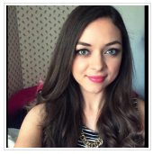
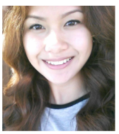
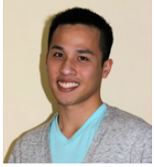
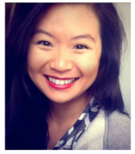
Board Members
President
Claudia
Gonzalez
Vice President
Joyce
Juniega
Treasurer
Trey Ngo
Social Media Coordinator
Chris Le
Volunteer Coordinator
Beverly Bares
Secretary
Sylvia La
Notes:
Everyone: option, year/expected graduation, cool fact

Slide 5

Ice Breaker
Notes:
Chris
Whoever wins will have lifesavers

Slide 6
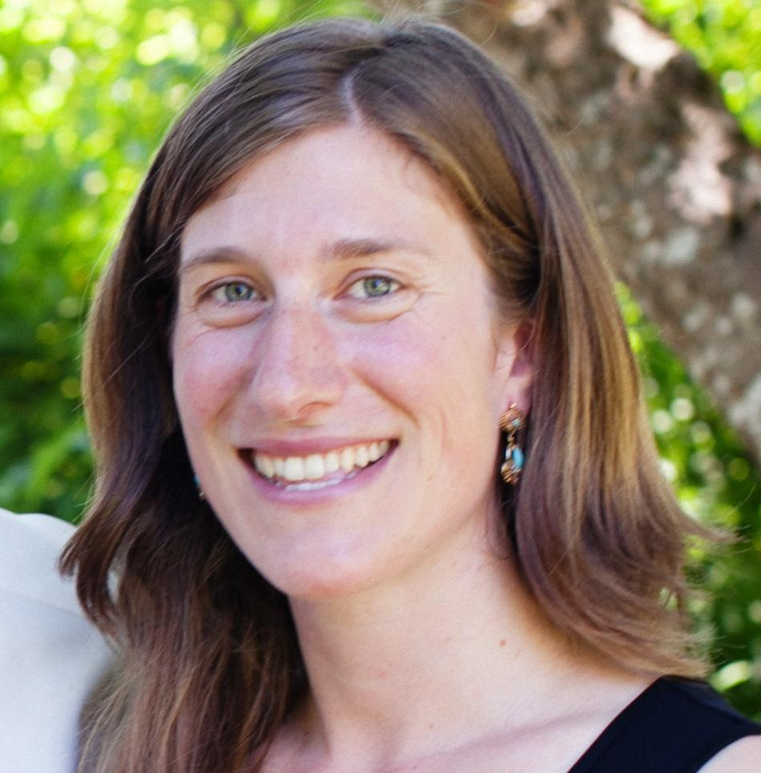
New for Fall 2015
New Faculty Advisor! Dr. Miranda Worthen
Assistant Professor of HSR
PhD, UC Berkeley, 2012
MPhil, International Development, Oxford University, 2006
BA, Government, Harvard University, 2001
Research: multi-disciplinary, mainly in conflict or post-conflict countries
teaches HS 161 & 261
Notes:
Joyce

Slide 7


Requirements:
Must be a declared Health Science major
3.0 SJSU GPA
3.5 Health Science GPA
20 hours of Community Service
2 events
Notes:
Beverly

Slide 8


Requirements
20 hours of volunteering
  Not paid
  Can’t be part of a class
Volunteer Opportunities
  Comida Casera
  Volunteer now http://as.sjsu.edu/cccac/index.jsp?val=cccac_volunteernow
  VolunteerMatch.org http://www.volunteermatch.org
2 events
  PHE
  Writing Workshop
  SJSU Academic Events
  Outside events (health-related)
  HS2 Events
  HLO Mixer Panel
Notes:
Beverly
What counts:
PHE Events
Workshops
SJSU Events
Volunteering Service:

Slide 9

Member Meetings
We are aiming for once a month mandatory meetings
Fill out Google form for availability
http://goo.gl/forms/HcdywLTSJq
Notes:
Joyce

Slide 10
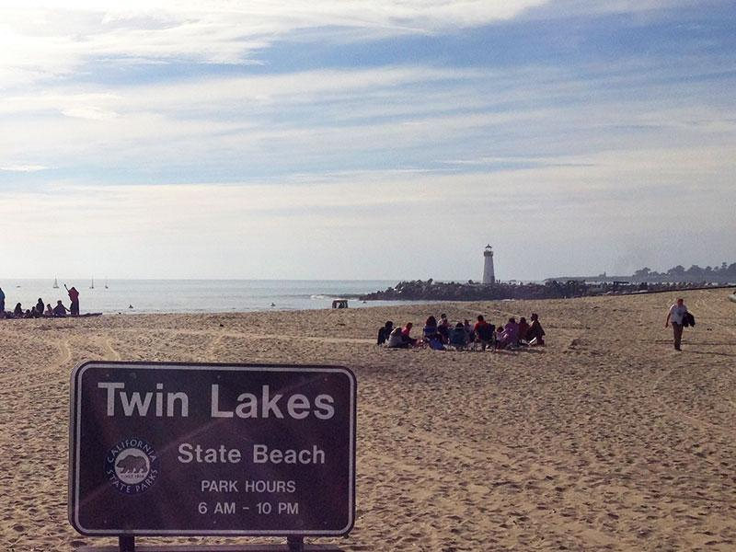
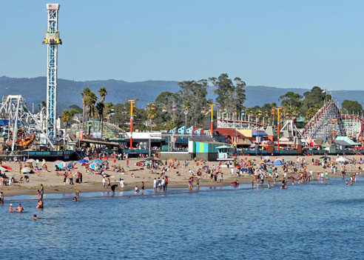
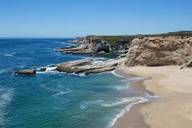
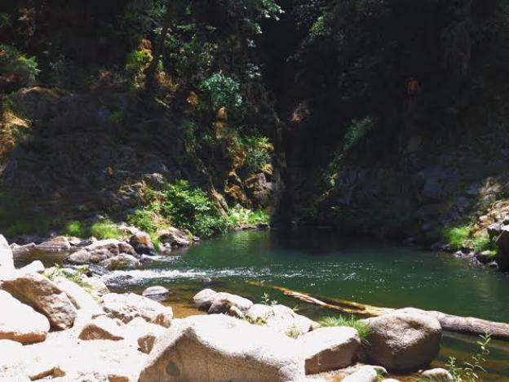
September Events
Friday, September 25
Leave campus @ 12:00 pm
Santa Cruz Boardwalk
Garden of Eden
Panther Beach
Notes:
Sylvia

Slide 11

September Events
Volunteering Opportunities
Superhero Run/Health Fair Expo
  September 19 @ 8:00 AM - 2:00 PM
  Must sign up on Eventbrite
HS 104 Pulga
  Sat. September 26 @ 8:00 AM- 12:00 PM
http://www.eventbrite.com/e/superhero-runhealth-fair-expo-tickets-18041133516
Notes:
Sylvia

Slide 12
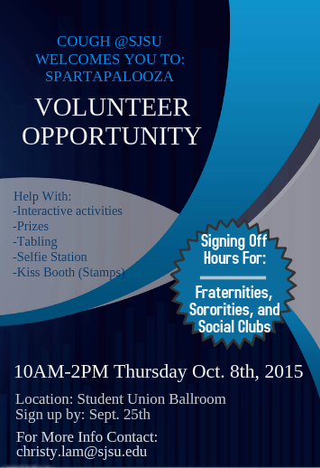
October Events
HS 104 Salud Carnivale
  Thursday, October 8
  8:00 am- 6:00 pm
Aga Khan Foundation Walk|Run - Silicon Valley
  Sunday, October 11
  Sunnyvale Bayland’s Park
  Family Friendly Activities
  See flyer for more details.
  Contact: Shazia Salim
    shazia2292@yahoo.com
Notes:
Joyce

Slide 13
October Events
The Leukemia & Lymphoma Society Light The Night Walk
  Sat, Oct 24; 12:00pm - 10:00pm
  Discovery Meadow, 1880 Woz Way, San Jose, CA 95110
  Register online: http://www.lightthenight.org
American Cancer Society
  Help set up for Strides Walk
  Fri, Oct 30; 10:00am - 4:00pm
  325 W. St John Street, Arena Green and Guadalupe River Trail, San Jose, CA 95110
  Register online: http://main.acsevents.org/site/TR/MakingStridesAgainstBreastCancer/MSABCCY15CA?pg=entry&fr_id=69970
Notes:
Sylvia

Slide 14

October Events
Love Every Body
  Oct. 14 @ 12:30 PM - 1:30 PM
  Student Wellness Center - Room: 122A
Healthy Relationships
  Oct. 14 @ 1:30 PM - 2:30 PM
  Student Wellness Center - Room: 122A
Reflecting Images
  Oct. 15 @ 3:00 PM - 4:00 PM
  Student Wellness Center - Room: 122A
Body Talk
  Oct. 15 @ 6:00 PM - 7:30 PM
  SWC Wellness Lounge 101
Spartapalooza
  Oct. 8 @ 8:00 AM - 3:00 PM
  Student Union Ballroom
  Contact: Anna Ang
    anna.ang@sjsu.edu
http://www.sjsu.edu/events
Notes:
Chris
Note:
Arrive 15 min. early for a seat
Even may be cancelled if depending on how many students registered

Slide 15

HS2 Fees
One-time membership fee of $80
Why?
Can be paid in installments, please talk to Trey about further information TreyNgo@gmail.com
Notes:
Trey- money goes to stoles and also any public events we have, they will cover food. Also the money would go to awards/certificates, T-shirts, guest speaker gratitude gifts.

Slide 16
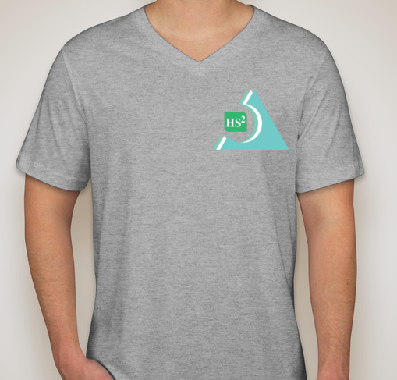

HS2 Shirts
Show of hand for your shirt size:
Xsmall
Small
Medium
Large
Xlarge
Note- $5 per shirt
Notes:
Trey

Slide 17

Fundraising
Fundraising Goal: $500
Fundraising groups
Any recommendations or ideas?
  Food sales
  Restaurant fundraisers
  Sport game raffles
50% of proceeds will go to UNICEF to help Syrian Children
Notes:
Claudia

Slide 18

Fundraising
Announcement
Internship opportunity
graduated HS2 member, Anne Marie
Santa Clara County Adult Custody Health Services
student interns needed for fall and spring semesters, 10-20hrs/week, flexible schedule
anyone who is interested in healthcare administration, data analysis, EHRs, mental health, or correctional medicine
forward email to you if interested
Notes:
Joyce

Slide 19




Contact Us
healthsciencehonorsociety@gmail.com
www.SJSUHS2.weebly.com
https://www.facebook.com/groups/252381281501540/
search for “Health Science Honor Society (HS2)
@sjsu_hs2
Notes:
Chris

Slide 20

Questions?
Comments?

Slide 21
Thank you!

