Slide 1
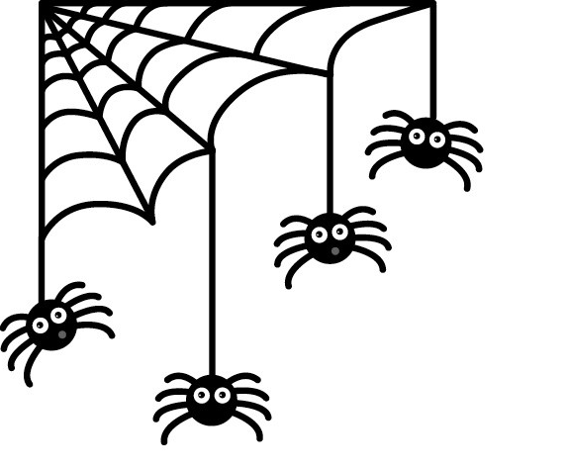
Health Science Honor Society
YUH 243 @ 6:00 PM
October 22, 2015
Notes:
start @ 6:05pm
Members attending online meeting 10/18/2015 @ 9PM
April Cruda
Samantha Nguyen
Mary Grace Ramos
Keleigh Casey
Jacklyn Tran
Eusebia Hotchkiss
Maureen
Jennifer Cover
Rippal
Isaac Velasquez
Alyssa Hernandez
James Whitney

Slide 2
Agenda
Introduction
Ice Breaker
New Google Group
Fundraising
October HS2 Event
Events for this semester
Stoles & chords
T-shirts
Questions
Notes:
Claudia

Slide 3
Requirement Reminder
20 hours of volunteering
Not paid
Can’t be part of a class
2 events
Academic events
On-campus or off-campus
HS2 events
Deadline at the beginning of Spring semester
Deadline for graduating seniors is December 4th
Notes:
Beverly
What counts:
PHE Events
Workshops
SJSU Events
Volunteering Service:

Slide 4
Ice Breaker
Notes:
online - everyone goes around and answer question
in person -

Slide 5
New Google Group
Very important to be part of it!
We need your email to send you an invitation to join
Send your own posts to
healthsciencehonorsociety@googlegroups.com
Notes:
Joyce

Slide 6
Fundraising
Fundraising Goal: $500
Fundraising groups
Any recommendations or ideas?
Food sales
Restaurant fundraisers
Sport game raffles
50% of proceeds will go to UNICEF to help Syrian Children
Notes:
Claudia

Slide 7
Fundraising
Let’s make a list of fundraising ideas
Take a poll/ Create groups
A board member will join each team
Create a way of communication for all team members
Set goals and action plan

Slide 8
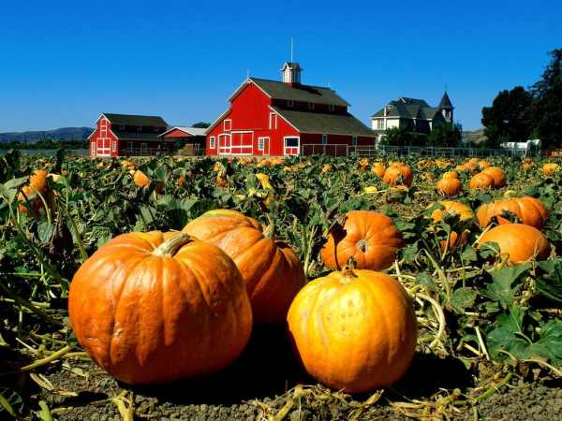
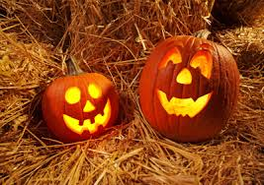
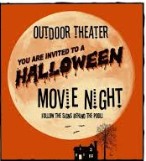
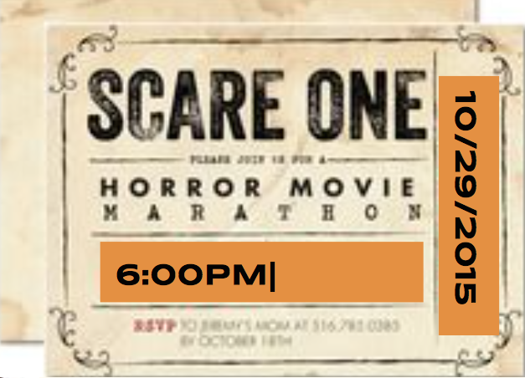
October HS2 Event
OCTOBER 29, 2015 @ 6:00PM
hs2 movie night
or
or
Notes:
Beverly

Slide 9
October Event Opportunities
The Leukemia & Lymphoma Society Light The Night Walk
Sat, Oct 24; 12:00pm - 10:00pm
Discovery Meadow, 1880 Woz Way, San Jose, CA 95110
Register online: http://www.lightthenight.org
American Cancer Society
Help set up for Strides Walk
Fri, Oct 30; 10:00am - 4:00pm
325 W. St John Street, Arena Green and Guadalupe River Trail, San Jose, CA 95110
Register online: http://main.acsevents.org/site/TR/MakingStridesAgainstBreastCancer/MSABCCY15CA?pg=entry&fr_id=69970
Notes:
Beverly

Slide 10
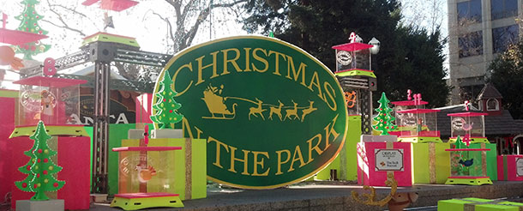
November HS2 Event
Christmas in the Park
HS2 bought a tree and
we will decorate it.
Tree ornament making event on Thursday Nov 12!
Tree decorating Nov 24-25.
Rain & wind resistant. Keep a lookout for ideas and supplies.
Notes:
Sylvia

Slide 11
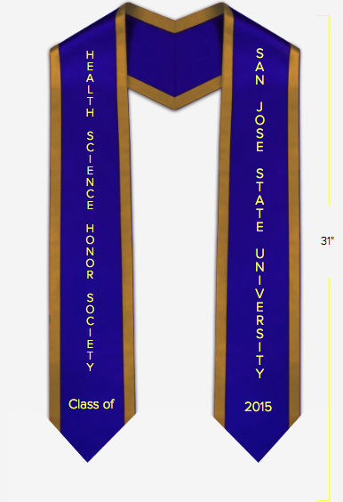
Stoles and Cords
Congratulations!
Requirements for stoles and cords:
2 events
20 volunteer hours
Due December 4th for graduating seniors!
Notes:
Chris
Note:
Arrive 15 min. early for a seat
Even may be cancelled if depending on how many students registered

Slide 12
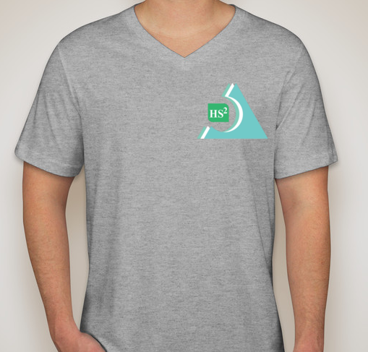
HS2 Shirts
Xsmall
Small
Medium
Large
Xlarge
Note- $5 per shirt
Notes:
Trey

Slide 13
Next Member Meetings
We are aiming for once a month mandatory meetings
November
Thursday 11/12 @ 6:00 pm (on-campus)
Sunday 11/15 @9:00 pm (online)
December
TBA
Notes:
Joyce

Slide 14
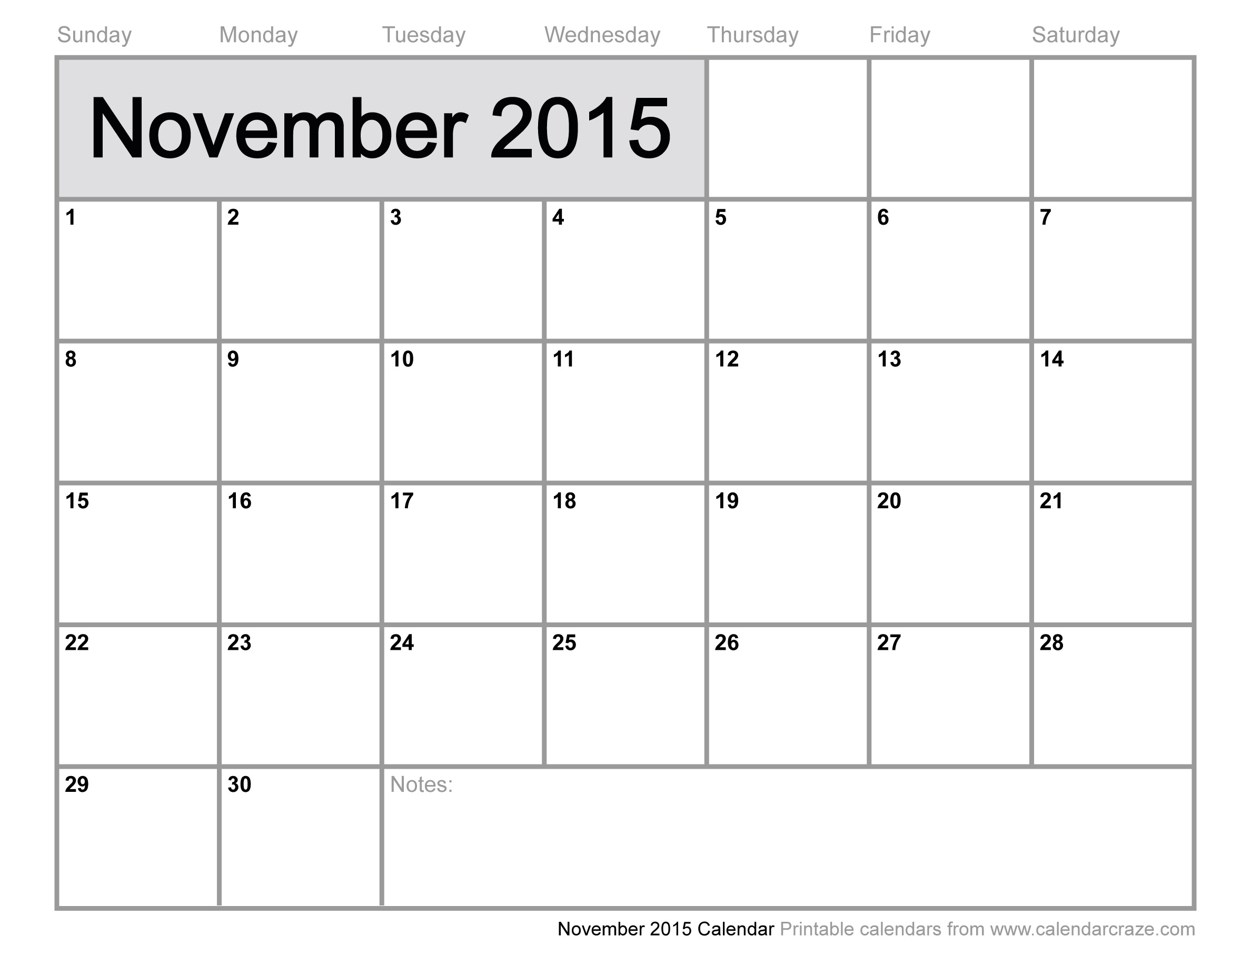
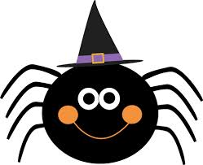
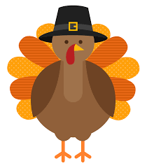
29 30 31
Movie or pumpkin patch
Halloween
Campus meeting!
Online meeting
Christmas in the Park tree decorating
Thanksgiving
Christmas at the Park tree decorating
Graduating Seniors’ hours and events due December 4
Notes:
Trey

Slide 15
Contact Us
healthsciencehonorsociety@gmail.com
www.SJSUHS2.weebly.com
search for “Health Science Honor Society (HS2)
@sjsu_hs2
Notes:
Chris

Slide 16
Questions?
Comments?

Slide 17
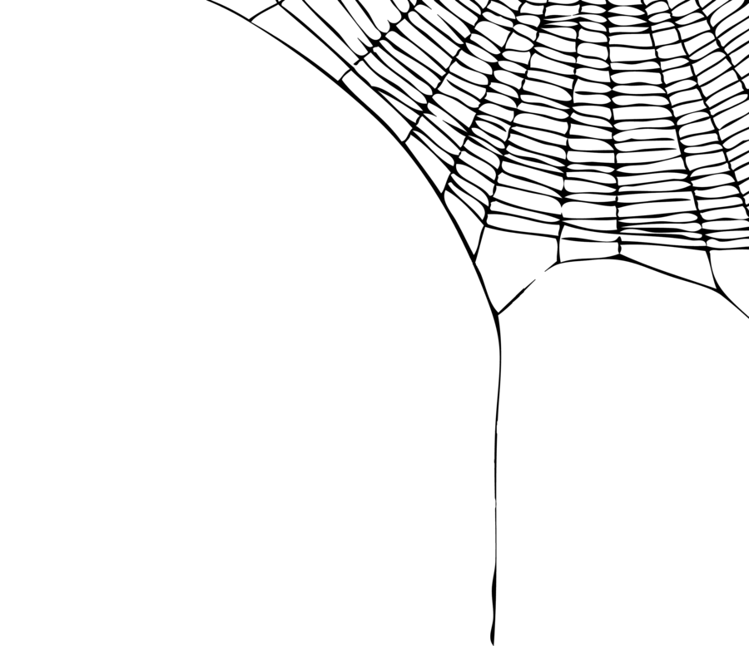
Thank you!

